Slide 1
UNIT - II
Installation n Configuration of Android (6 Hrs – 6 marks)

Slide 2
System Requirement
Microsoft windows 7/8/10 (32 or 64 bit)
4GB RAM minimum , 8GB RAM recommended.
2GB of available disk space minimum , 4GB recommended (500MB for IDE + 1.5 GB –Android SDK and emulator system image)
1280 X 800 minimum screen resolution

Slide 3
Android Setup
Android application development can be done on either of the following operating systems −
-Microsoft Windows XP or later version.
-Mac OS X 10.5.8 or later version with Intel chip.
-Linux
Following is the list of to start your Android application programming.
- Java JDK5 or later version
-Android Studio

Slide 4
Java Development Kit (JDK)
download the latest version of Java JDK from Oracle's Java site − Java SE Download

Slide 5
Android SDK (Software development kit)
SDK provides a selection of tools required to build Android apps or to ensure the process goes as smoothly as possible.
SDK provide a kind of bridge between Android Studio and a physical device or emulator so that app can be appropriately packaged and then tested.
creating an app with Java, Kotlin or C#, you need the SDK to get it to run on an Android device.

Slide 6
Android SDK (Software development kit)
The Android SDK (software development kit) is a set of development tools used to develop applications for Android platform. The Android SDK includes the following:
Required libraries
Debugger
An emulator
Relevant documentation for the Android application program interfaces (APIs)
Sample source code
Tutorials for the Android OS
when the SDK Tools are updated or a new version of the Android platform is released, you can use the SDK Manager to quickly download them to your environment.

Slide 7
Android SDK Components….
Platform-tools :It includes tools that interface with the Android platform.
Build-tools : Android SDK Build-Tools is a component of the Android SDK required for building Android apps.
SDK-tools : It includes the complete set of development and debugging tools for Android. It is included with Android Studio.
The Android Debug Bridge (ADB) : “bridge” of communication between Android devices and computers that can be used during development.
connecting an Android device to the development PC .
Android Emulator : The Android Emulator simulates Android devices on your computer so that you can test your application on a variety of devices without needing to have each physical device.
Use the Android Virtual Device manager in order to choose which version of Android you want to emulate

Slide 8
Android development tools (ADT)
1. Android Studio :
Android Studio provides code editing, debugging, and testing tools all within an easy-to-use drag-and-drop interface.
Android Studio is the official IDE for Android development, and includes everything you need to build Android apps.
2. Eclipse
There was Eclipse before there was Android Studio. For a long time, Eclipse was the officially preferred IDE for all Android application development.
Instabug:
Instabug allows beta testers and user groups to share screenshots and detailed error logs with developers during the QA
GameMaker: Studio:
GameMaker provides everything you need to create 2D games using very little code.

Slide 9
Android Virtual devices (AVD)
An Android Virtual Device (AVD) is a configuration that defines the characteristics of an Android phone, tablet, Android TV , that you want to simulate in the Android Emulator.
AVD manager enables an easy way of creating and managing the AVD with its graphical interface.
To open AVD manager, go to Tools → Android → AVD Manager
1. Hardware profile :Select Hardware type for your virtual device. This list contains almost all the Android devices with their respective settings.
2. System Image : selecting Android Version for your newly created virtual device or Download the one you want, by clicking on the Download option

Slide 10
Emulators…
Emulator :An emulator is a software program that allows your mobile to imitate the features of another computer or mobile software
An Android emulator is an Android Virtual Device (AVD) that represents a specific Android device. You can use an Android emulator as a target platform to run and test your Android applications on your PC.
The Android emulator mimics all of the hardware and software features of a typical mobile device, except that it cannot place actual phone calls.

Slide 11
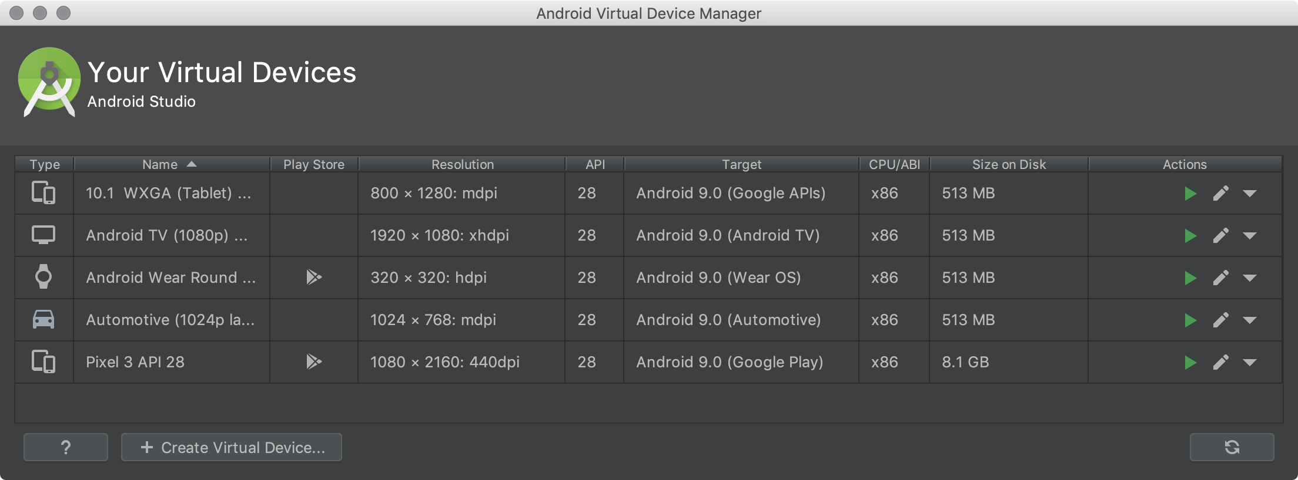
Open the AVD Manager by clicking Tools > AVD Manager

Slide 12
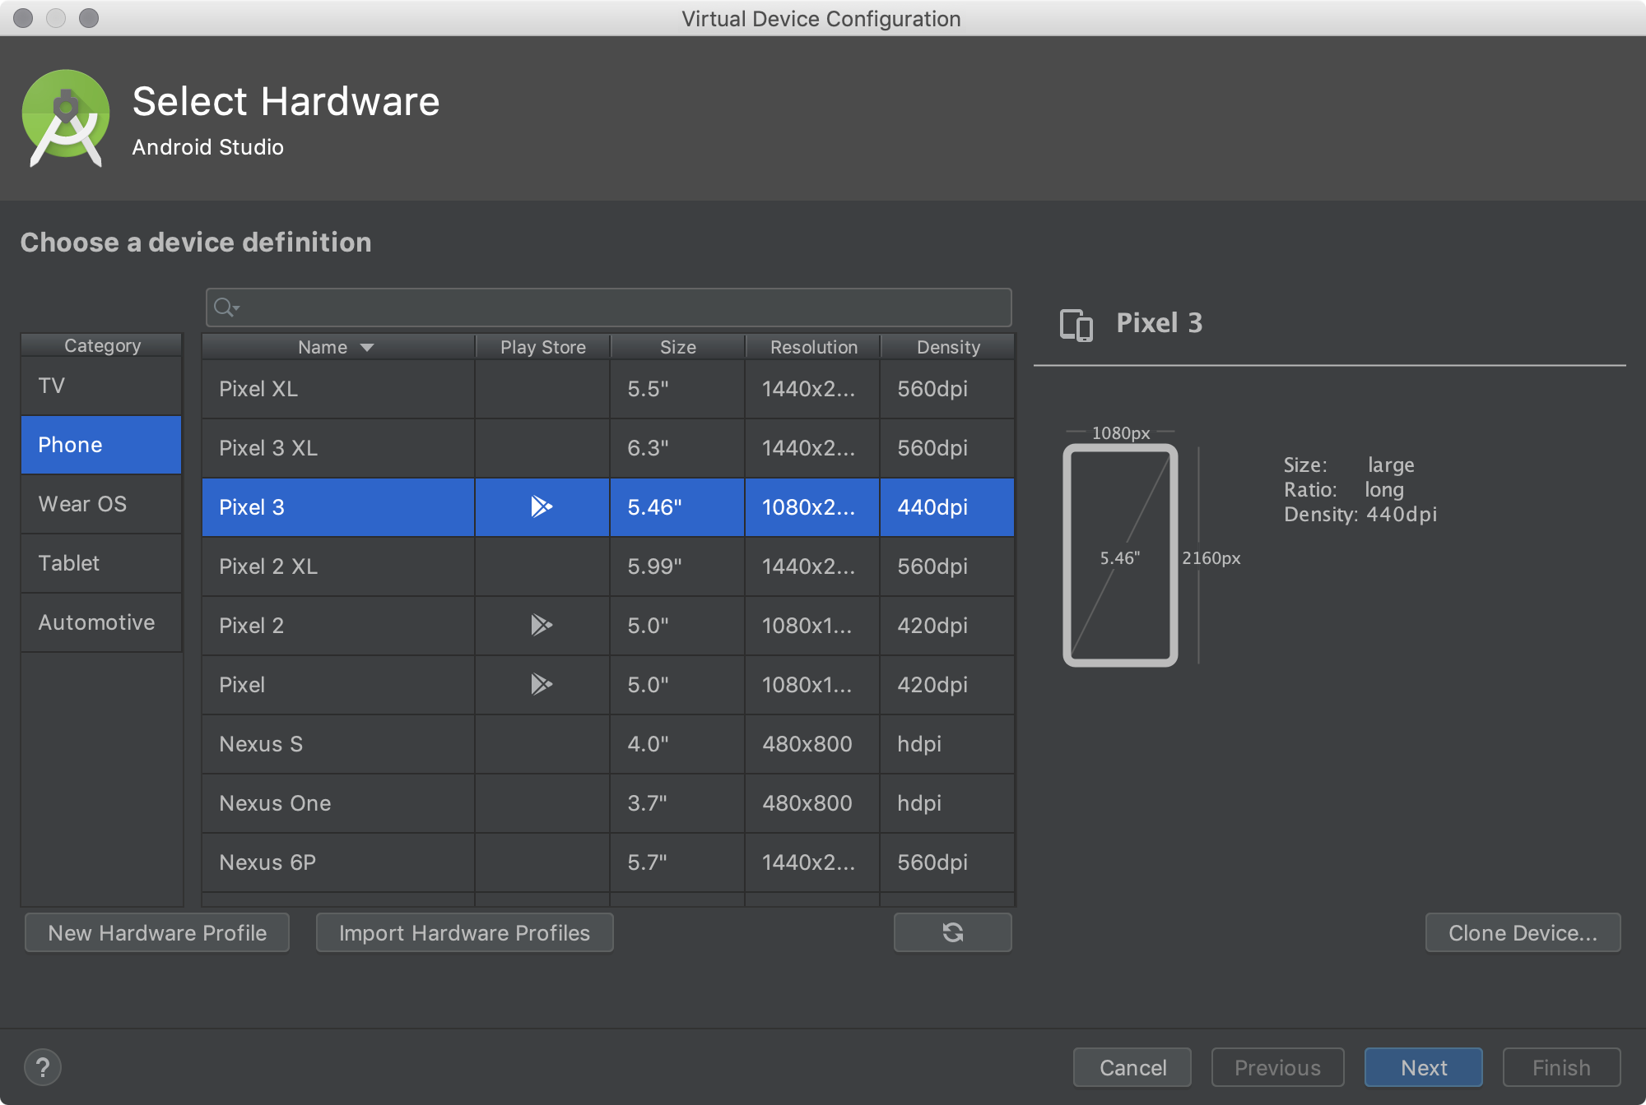
Click Create Virtual Device, at the bottom of the AVD Manager dialog.The Select Hardware page appears

Slide 13
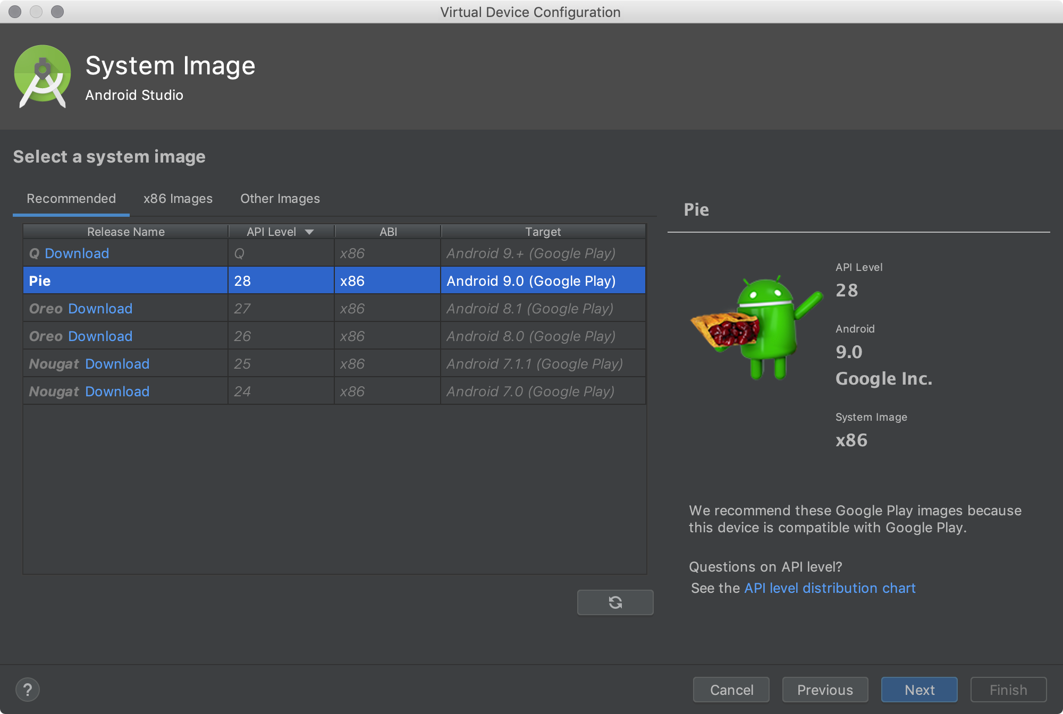
Select the system image for a particular API level, and then click Next.

Slide 14
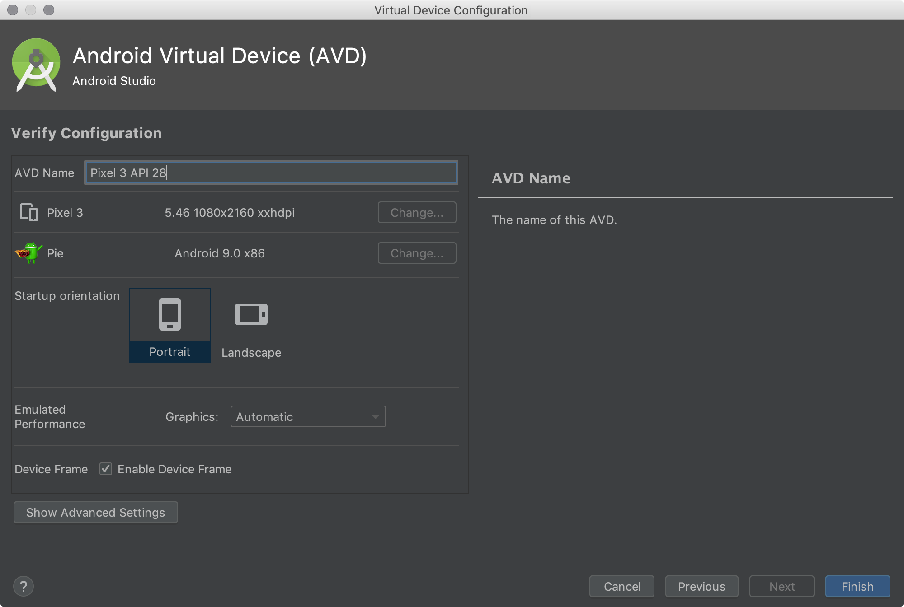
Change AVD properties as needed, and then click Finish

Slide 15
Difference between AVD and Emulator
An Android Virtual Device (AVD) is an emulator configuration that lets you model an actual device by defining hardware and software options to be emulated by the Android Emulator

Slide 16
Why Android use Virtual Machine?
Android makes use of a virtual machine as its runtime environment in order to run the APK files that constitute an Android application.
The application code is isolated from the core OS : even if any code contains some malicious code won’t directly affect the system files.
It provides cross compatibility or platform independency: even if an app is compiled on platform such as a PC, it can still be executed on the mobile platform using the virtual machine.

Slide 17
What is meant by runtime environment
A runtime system provides an environment to translate the code written in a high-level language like Java to machine code and understandable by the Central Process Unit (CPU).

Slide 18
How to connect Mobile device
MOBILE –DEVICE :
1. SETTING—ABOUT PHONE—BUILD NUMBER(IMUI)(7 TIMES TOUCH)
2. SETTIN -- ADDITIONAL SETTING ---DEVELOPER OPTION—
-USB DEBUUGING (ENABLED)
INSTALL VIA USB(ENABLED)

Slide 19
Dalvik Virtual Machine….
JVM is high performance and provides excellent memory management. But it needs to be optimized for low-powered handheld devices as well.
The Dalvik Virtual Machine (DVM) is an android virtual machine optimized for mobile devices. It optimizes the virtual machine for memory, battery life and performance.
The DVM is a virtual machine to run Android applications. The DVM executes Dalvik bytecode, which is compiled from programs written in the Java language. Note that the DVM is not a JVM.
One of the key design principles of the DVM is that it should run on low memory mobile devices and loads quicker compared to any JVM.

Slide 20
With the Dalvik JIT (Just In Time)compiler, each time when the app is run, it dynamically translates a part of the Dalvik bytecode into machine code.
As the execution progresses, more bytecode is compiled and cached.
In Lolipop version google introduce ART(Android runtime environment).
DVM is replaced by ART for improved application performance battery usage.
ART is equipped with an Ahead-of-Time compiler. It statically translates the DEX bytecode into machine code
ART – performance is fast
- - Improved garbage collection
- introduce AOT (ahead of time )concept : compile the entire app at a time.
AAPT (Android Asset Packaging tool)
AAPT tool allow to view , create and update inside app
AAPT compile the resource (XML code ) to binary format to store in to device
Note : DVM has been replaced by ART. Because DVM converts bytecode every time you launch a specific app. But ART converts it just once during the installation of the app. That makes CPU execution easier.

Slide 21
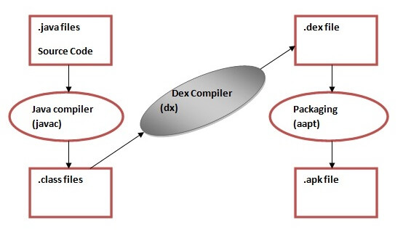

Slide 22
JVM and DVM
Architecture
The JVM is a stack-based VM where all the arithmetic and logic operations are carried out via push and pop operands and results are stored on the stack.
DVM is a register-based VM. These registers located in the CPU carry out all the arithmetic and logic operations.
Compilation
java code is compiled inside the JVM to an intermediary format called Java bytecode (.class files). Then, the JVM parses the resulting Java bytecode and translates it to machine code.
On an Android device, the DVM compiles the Java code to an intermediate format called Java bytecode (.class file) like the JVM. Then, with the help of a tool called Dalvik eXchange or dx, it transforms Java bytecode to Dalvik bytecode. Finally, the DVM translates the Dalvik bytecode to binary machine code.
Performance
Stack-based VM bytecode is very compact because the location of operands is implicitly on the operand stack. Register-based VM bytecode requires all the implicit operands to be part of an instruction. That indicates that the Register-based code size will usually be much larger than Stack-based bytecode.
On the other hand, register-based VM's can express computations using fewer VM instructions than a corresponding stack-based VM

Slide 23
Diffrence between JVM n DVM
DVM (Dalvik Virtual Machine) | JVM (Java Virtual Machine)
It is Register based which is designed to run on low memory. DVM is more efficient in terms of memory usage and performance. (limited memory and power , low CPU speed) | It is Stack based. JVM is less efficient than DVM
DVM uses its own byte code and runs “.Dex” file. | JVM uses java byte code and runs “.class” file having JIT (Just In Time).
DVM has been designed so that a device can run multiple instances of the VM efficiently. Applications are given their own instance. | Single instance of JVM is shared with multiple applications.
DVM supports Android operating system only. | JVM supports multiple operating systems.
 | .
DVM runs .Dex file (Dalvik Executable File) | JVM runs .class files.
Here the executable is APK. | Here the executable is JAR.

Slide 24
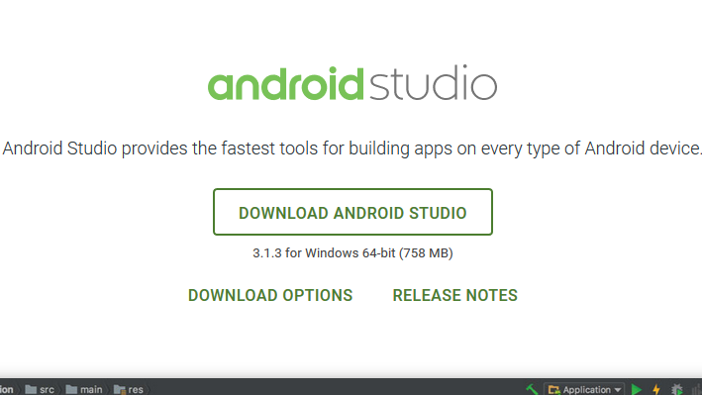
Steps to install Android Studio n SDK
Step – 1 : Head over to this link to get the Android Studio executable or zip file .
Step – 2 : Click on the download android studio button .

Slide 25
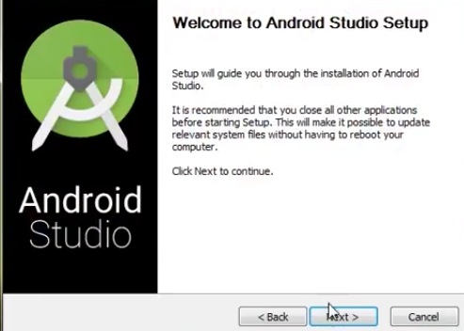
Step – 3:After the downloading has finished, open the file from downloads and run it . It will prompt the following dialogue box .

Slide 26
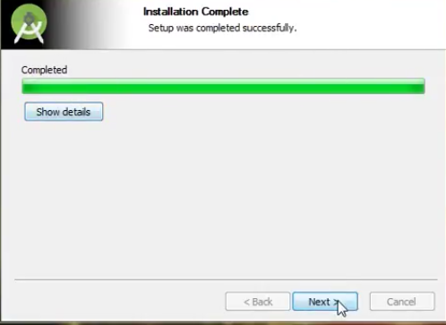
Step – 4 :It will start the installation, and once it is completed, it will be like the image shown below .

Slide 27
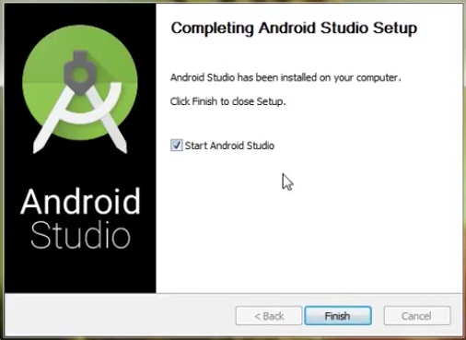
Click on next .

Slide 28
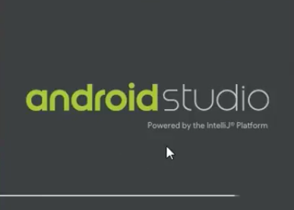

Step – 6 :This will start the Android Studio.
Meanwhile it will be finding the available SDK components .

Slide 29
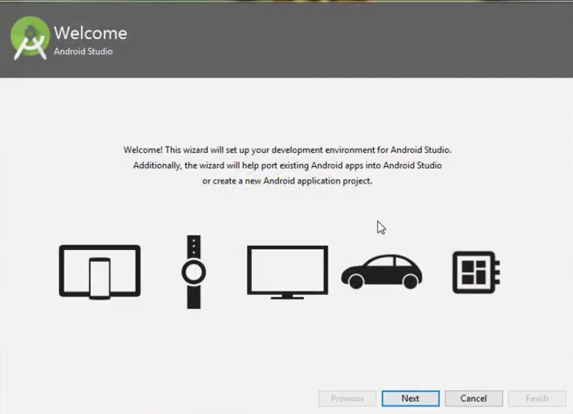
Step – 7:After it has found the SDK components, it will redirect to the Welcome dialog box .

Slide 30
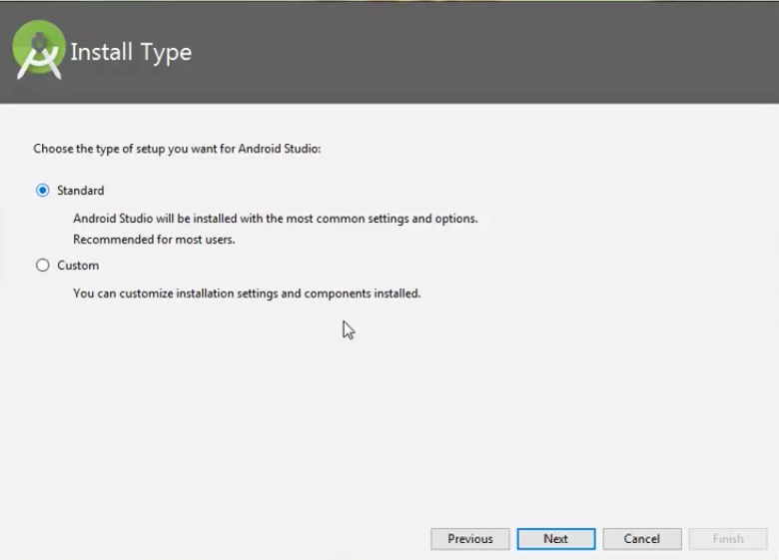
Click on next .

Slide 31
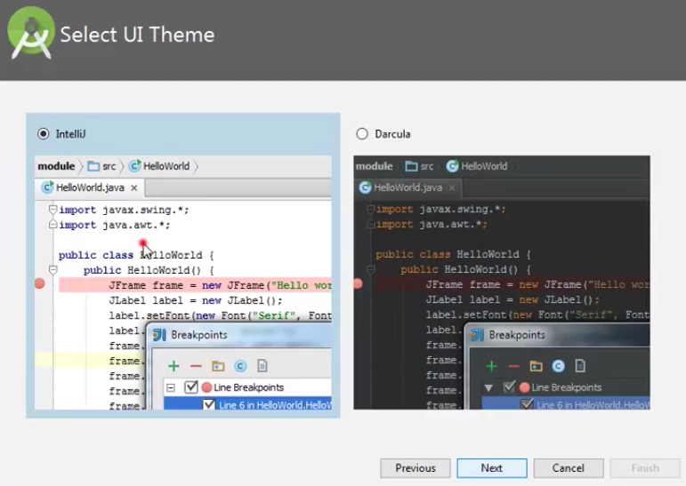
Now choose the theme, whether Light theme or the Dark one .

Slide 32
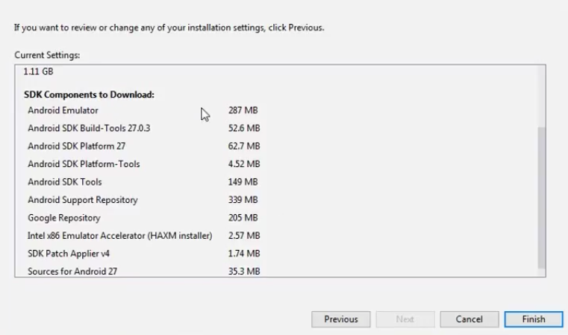
Step – 8 :Now it is time to download the SDK components .

Slide 33
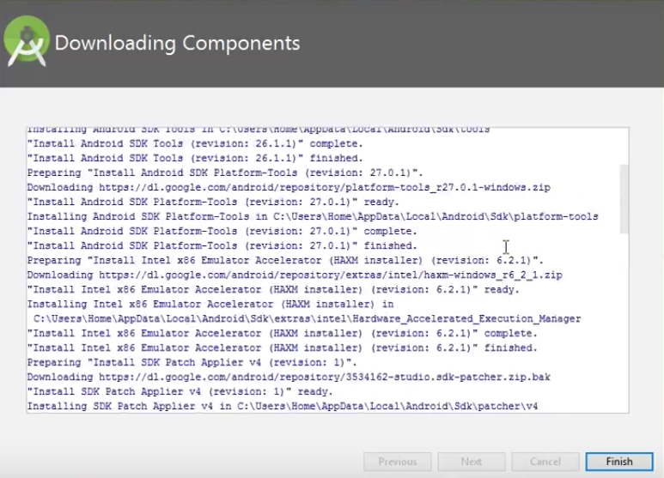
has started downloading the components

Slide 34
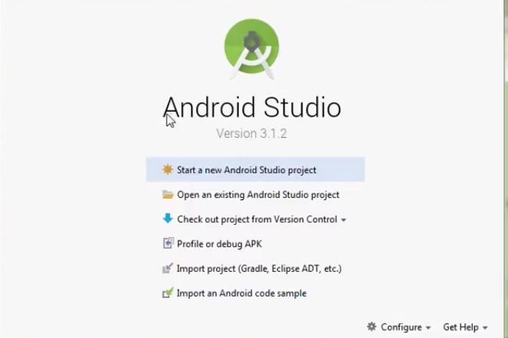
The Android Studio has been successfully configured.
Click on ‘Start new android project’ to build a new app.

Slide 35
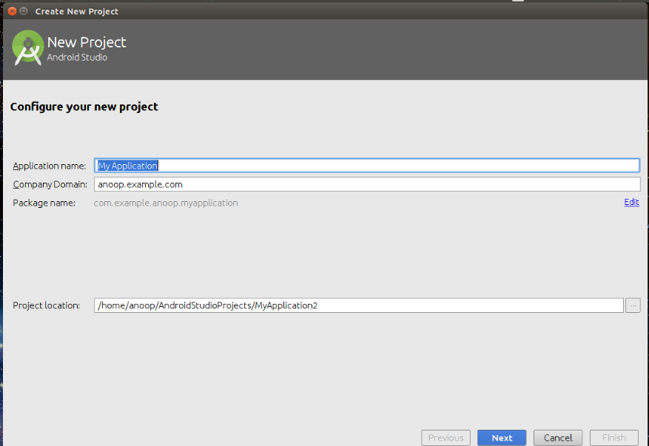
name your application in the ‘Application name‘ Text box

Slide 36
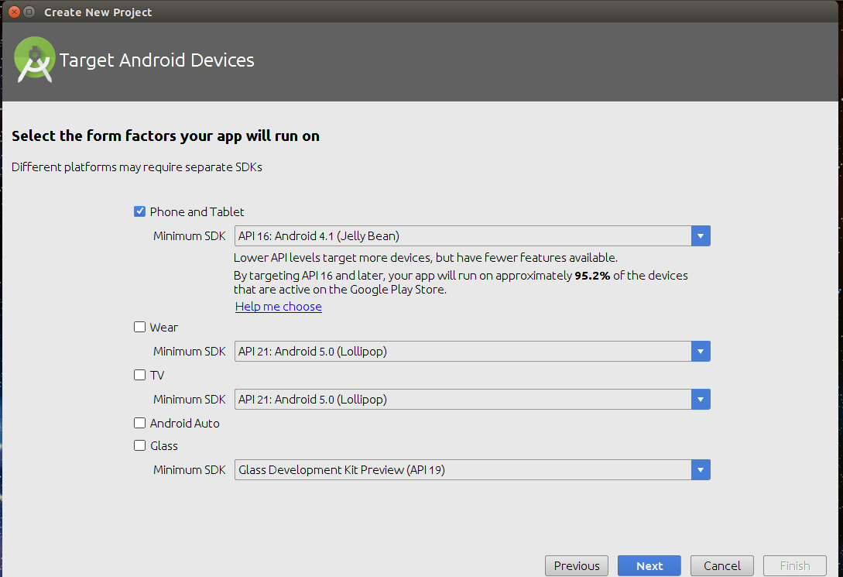
select the Minimum SDK to select the operating system which must be least version to run your app, here “Jelly Bean” is made Minimum SDK,

Slide 37
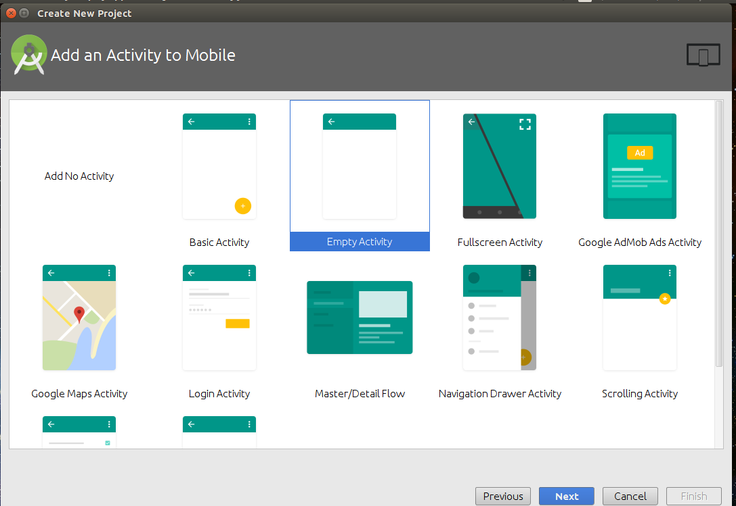
The next step is to choose the Activity to mobile. Activity in Android refers to a single screen with a user interface. For Beginners, “Empty Activity” is recommended.

